Slide 1
Introduction to WordPress with SiteControl
By: Web Services

Slide 2
What is WordPress?
A Content Management System (CMS)
Open source software
Originally developed as blogging software
Now used as a tool to create dynamic websites
Completely Free

Slide 3
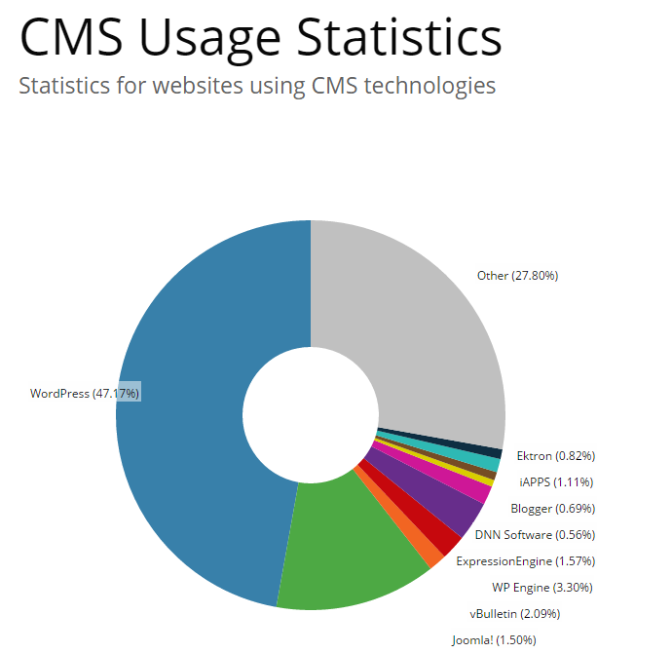
Source: http://trends.builtwith.com/cms

Slide 4
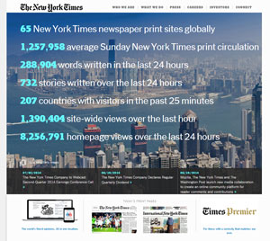
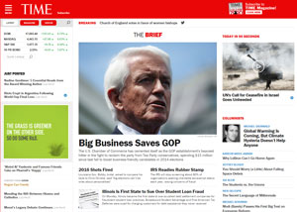
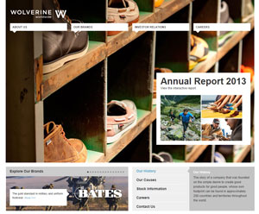
Who uses WordPress?
The New York Times (http://www.nytco.com/)
TIME (http://time.com/)
Sony Music (http://www.sonymusic.com/)
BBC America (http://www.bbcamerica.com/)
The Rolling Stones (http://www.rollingstones.com/)
Wolverine Worldwide (http://www.wolverineworldwide.com/)
And many, many more (http://wordpress.org/showcase/archives/)

Slide 5
Why is WordPress so Popular?
Easy to use
Huge amount of online help and documentation
Thousands of plugins
Easily add functionality to your existing site
Free Themes
Thousands of free themes are available online
Built in Search Engine
Search Engine Optimised

Slide 6
WordPress as a CMS
Allows for multiple users
Add, edit, or remove users as needed
Give users only the permissions they need
Easily edit pages, posts, and uploaded media
Added functionality through Plugins
Easily maintain your website and keep it up to date
Intuitive interface

Slide 7
WordPress Terms
Page
A webpage – static
Use pages for content that doesn’t change (About Us, Locations, etc)
Posts
A single entry
Use posts for time sensitive content (Fraud Alert, Promotional item, etc)
Widget
Areas of content you can add to your site without code knowledge
Plugin
Code that adds additional functionality to your website

Slide 8
WordPress Terms con’t
Media Library
Contains all uploaded files (images, documents, etc)
Theme
The style/layout of your site - Web Services builds custom themes for our clients
SiteControl
A plugin created by Web Services which: Adds calculators, rateboards, membership links, external link warnings, online banking logins.
Categories
Allows users to organize their content for easy access
Forms
Allows users to create dynamic forms (Example: http://ws.cuanswers.com/development/design/web-services-website-redesign-survey/)

Slide 9
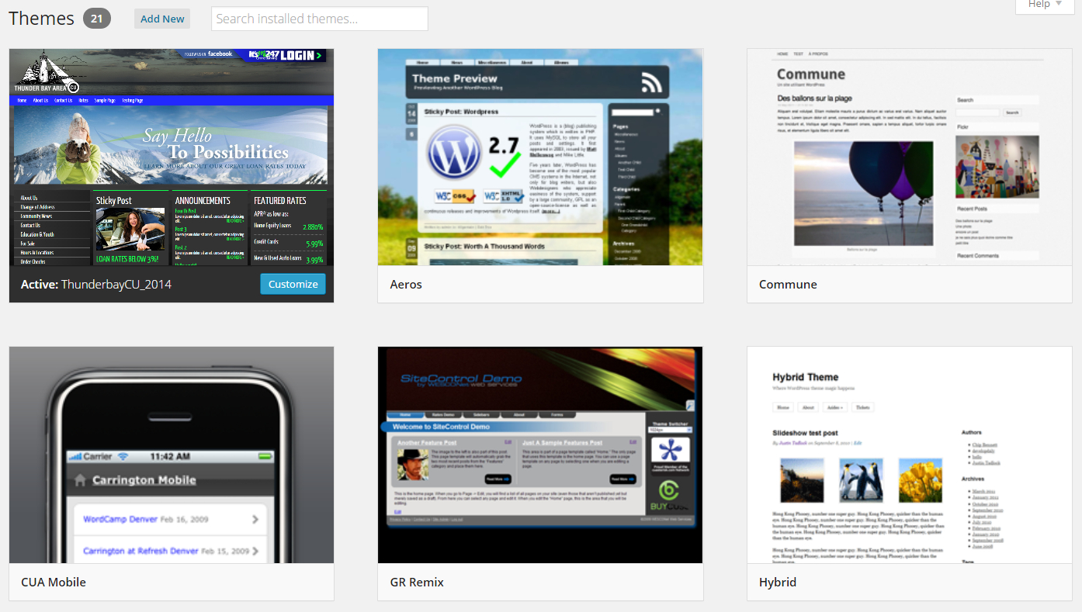
Themes
Themes are files that work together to create the design and functionality of a WordPress Site

Slide 10
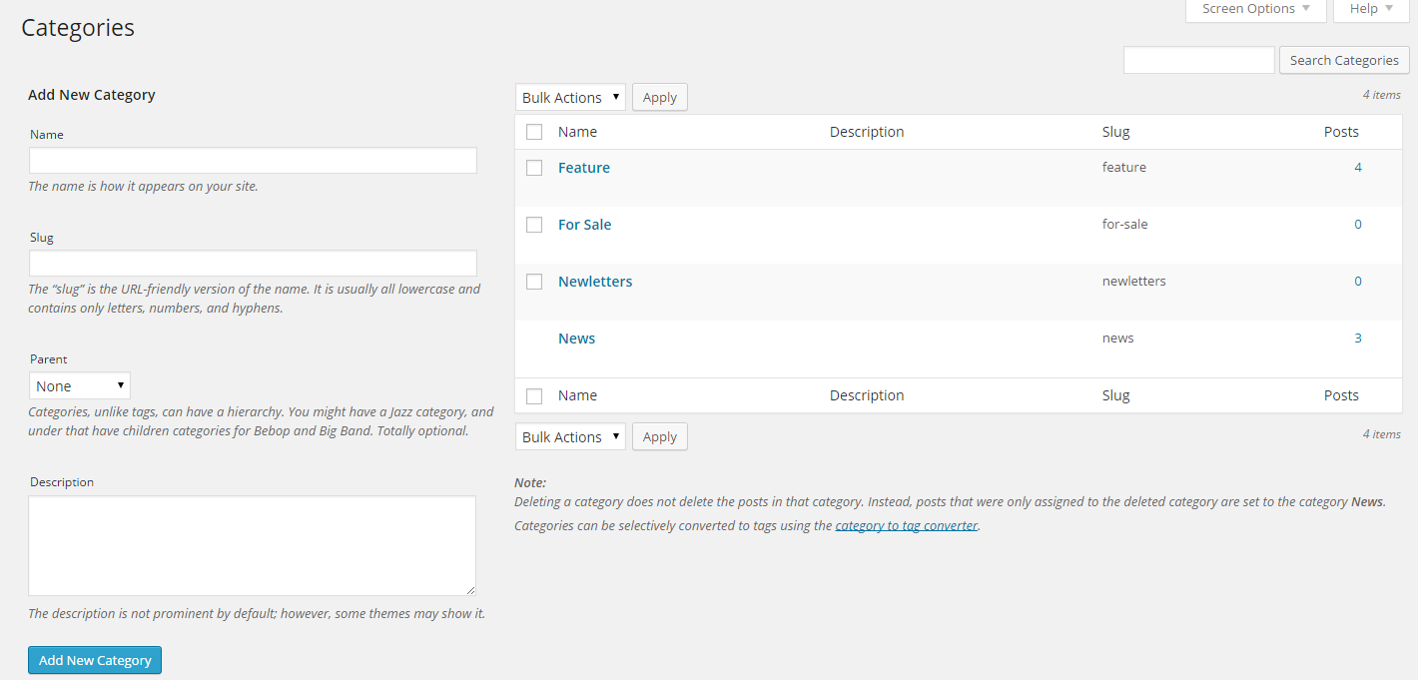
Post Categories
Uses:
Organize posts
Use custom CSS styles based on post category
Show certain posts in different areas – dynamic
Easily add new Categories

Slide 11
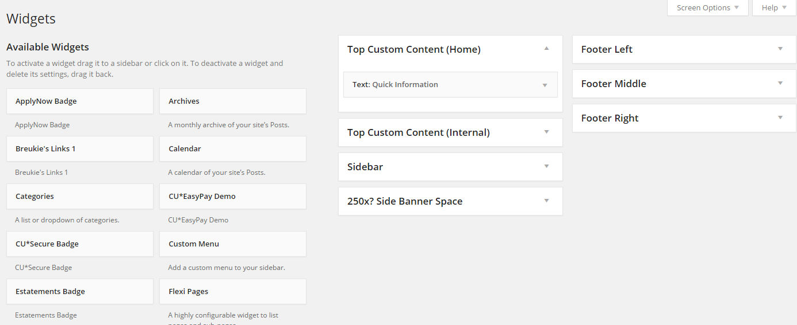
Widgets
Flexible areas designed to hold content
Most themes come with widget areas for further site customization

Slide 12
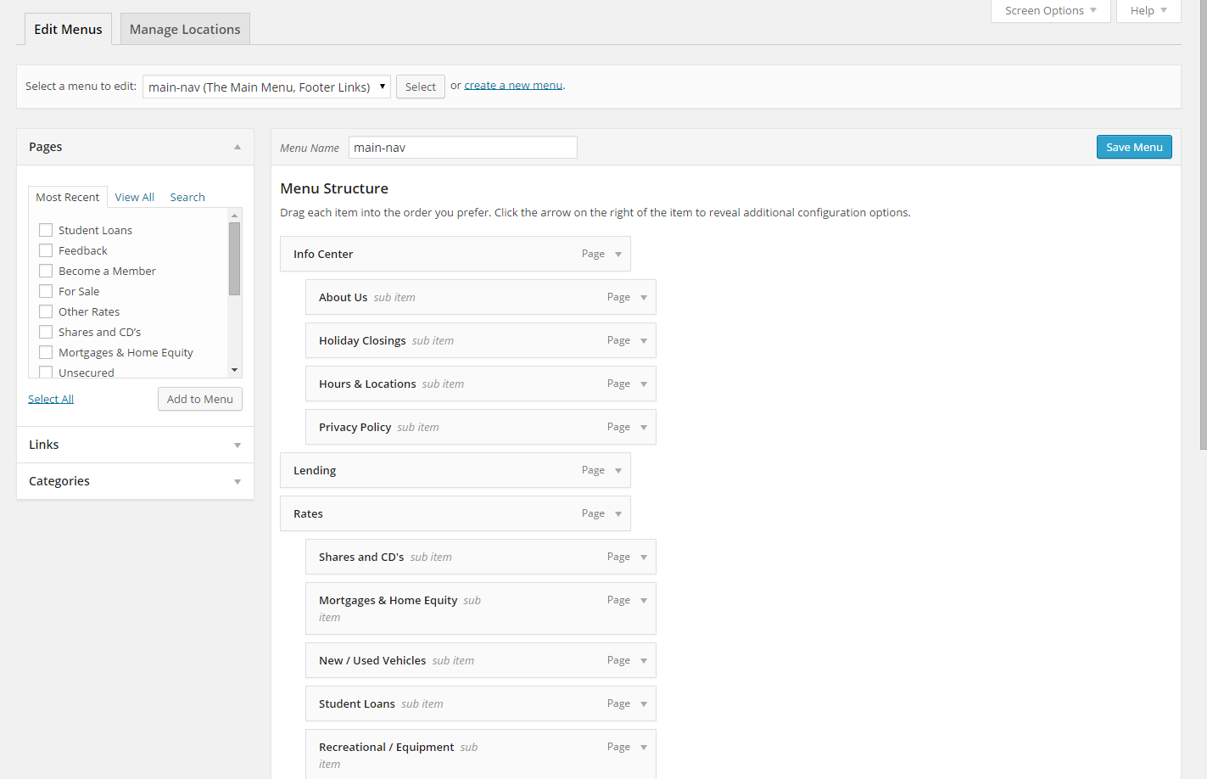
Menus
Gives control over how your pages are listed
Easily edit menus – drag and drop interface

Slide 13
Forms (Gravity Forms)
Powerful tools for creating dynamic forms

Slide 14
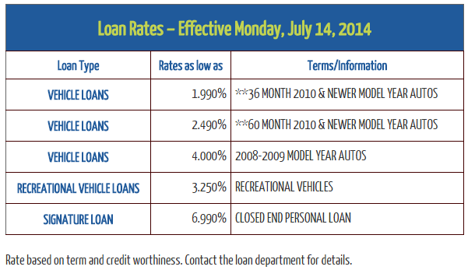
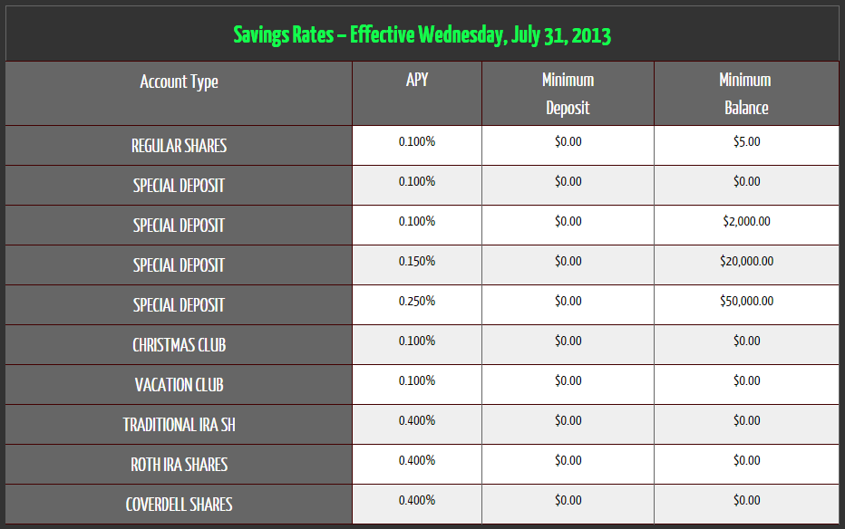
SiteControl - Rateboards
Automatically pulls rates from CU*Base and displays them on the website
Styled to match website theme
Takes 1 business day for new rates to be reflected

Slide 15
Best Practices
File Names – properly naming files will help organize your website and making searching for existing content easier
Example: Newsletter_Q1_2014.pdf Banner_JulySavingsRates.jpg
Styles – All of the styles for your site are built into your theme
Avoid changing font, font sizes, and colors. (Visual consistency)
Images – Use appropriate images
Avoid clipart, and pixelated images
Make images web friendly – small file size, correct dimensions (Save For Web)
Ensure all images are free of copyright (or make sure you have permission)

Slide 16
Best Practices con’t
Content – Content is King
Use keywords and appropriate verbiage in your content
Helps SEO by having searched keywords associated with your content
Create new posts frequently
Helps SEO know your site is current and relevant to searched terms (newer = top)
Links – Keep links relevant and up-to-date
Broken links will hurt your website SEO and can annoy users
Contact – Make contact information easy to find
Many users may be checking for hours or locations – help them out!

